Slide 1
Environmental Management Sem-VIII

Slide 2
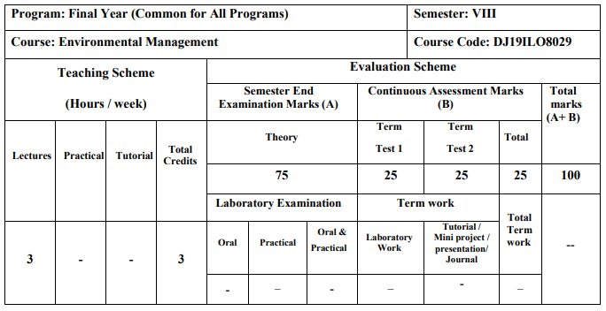
Schema & Syllabus

Slide 3
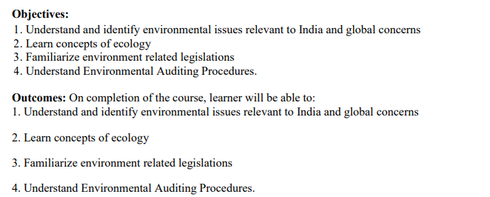
Objectives & Outcomes

Slide 4
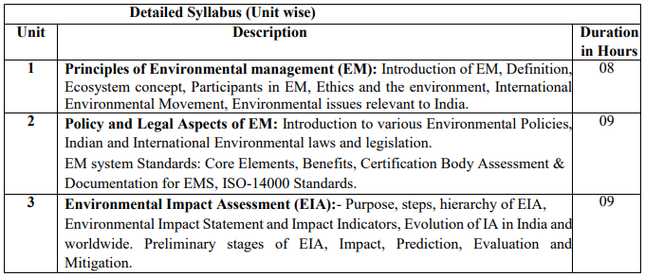
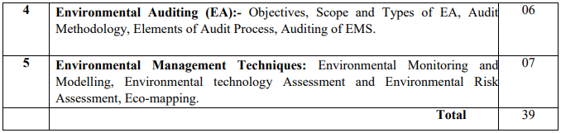
Syllabus

Slide 5
Module-1
Principles of Environmental Management (EM)
Contents:
Introduction of EM
Definition, Ecosystem concept
Participants in EM
Ethics and the environment
International Environmental Movement Environmental issues relevant to India

Slide 6
Introduction & Definition of Environment
Definition: Environment is the surroundings or control conditions in which all living organisms exist.
Our environment is everything that surrounds us, both natural and manmade.
Or the total sum of surroundings of living organism, including natural forces & other living things which provide conditions for development & growth as well as of danger & damage.
Or ENVIRONMENT: THE TOTAL OF OUR SURROUNDINGS • All the things around us with which we interact: • Living things • Animals, plants, forests, fungi, etc. • Nonliving things • Continents, oceans, clouds, soil, rocks • Our built environment • Buildings, human-created living centers • Social relationships and institutions
Thus the environment studies may vary from micro level to macro level.
Micro Level study: In case of some local studies such as ecosystem or solid waste management
Macro Level study: Global issues such as Green House Effect or Ozon depletion.

Slide 7
Types of pollutions: Air pollution, Water Pollution, Noise pollution, Land pollution
Pollution: It is deliberate or accidental contamination environment. Any manmade activity contributes to pollution with rapid urbanization & industrialization. There has been tremendous burden on natural resources.
→Every human kind must be aware about the pollution & types of pollutions.
→All the engineers are directly or indirectly have the greater concern about environment and its types. Engineers are the best dealer of the ways & means to overcome them.

Slide 8
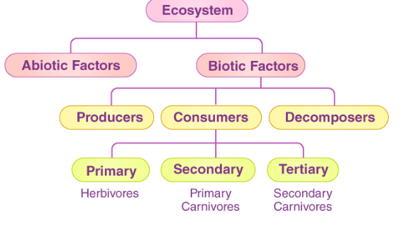
What is an Ecosystem?
An ecosystem is a structural and functional unit of ecology where the living organisms interact with each other and the surrounding environment. In other words, an ecosystem is a chain of interactions between organisms and their environment. The term “Ecosystem” was first coined by A.G.Tansley, an English botanist, in 1935.
Structure of the Ecosystem

Slide 9
Main Features of environment
Environment includes basically of living organisms (Biotic Factors) & nonliving factors (Abiotic factors) & their mutual interaction.
If proper balance between them then there is a healthy environment. (e.g. self sustaining ecosystem without the external interferences, especially man).
Due to unbalancing between above two factors a formation of environmental science is done, which is a part of environment. (degradation of environment)
(Unbalancing – e.g. when an industry discharges its waste in nearby water body, without proper treatment, there is an imbalance leading to degradation of environment & imbalanced ecology)

Slide 10
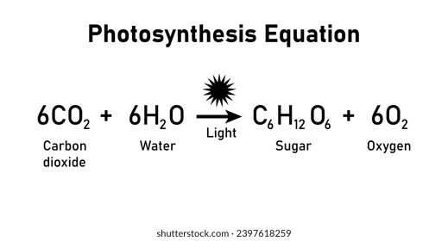
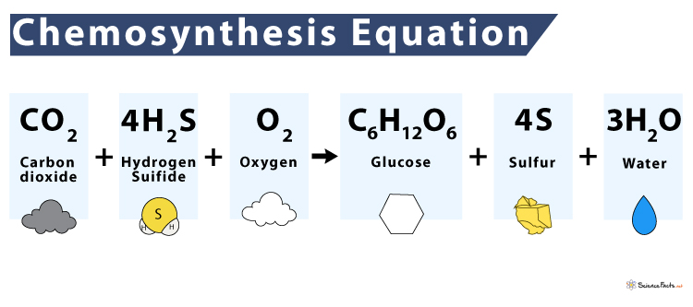
Biotic form (Any living part of an environment with which an organism might interact. Ex. Animals, plants, mushrooms, bacteria, etc. )
Autotrophs – Organisms that capture energy from sunlight or chemicals and convert it into forms, living cells can use.
Heterotrophs – can not make their own food; acquire energy from other organisms by ingesting (taking inside) them.
Producers – Make their own food.
Primary producers – the first producers of energy-rich compounds that are later used by other organisms.
→Autotrophs are primary producers!
→Most engage in the process of photosynthesis.
→Chemosynthesis – chemical energy is used to produce carbohydrates in dark conditions (like the deep oceans).

Slide 11
Consumers – organisms that rely on other organisms for energy and nutrients.
→Carnivores – kill and eat other animals.
→ Hunters – consume the bodies of dead animals.
Decomposers – chemically break down organic matter (bacteria and fungi are examples).
→Herbivores – eat plants.
→Omnivores – diets include both plant and animal matter.
→ Detritivores – feed on detritus (small pieces of decaying matter) by grinding them into smaller pieces (earthworms and snails are examples). Often digest the decomposers living on the detritus.

Slide 12
Abiotic factors (Nonliving part of the environment that influence the organism. Ex. Sunlight, heat, precipitation, humidity, wind, water current, soil type, etc.)
These factors mainly consist of non living part and can be broadly classified in following functional groups
Climatic factors: rainfall, light, temperature, atmospheric humidity & wind.
Physiographic factors:
→Factors that have their origin in the form, behavior
& structure of earth surface
→ Physical & chemical constituents of the soil(sandy, clayey), Presence of rivers, lakes, and seas, Groundwater availability , such as its structure, chemical properties etc.

Slide 13
Functions of Ecosystem
The functions of the ecosystem are as follows:
It regulates the essential ecological processes, supports life systems and renders stability.
It is also responsible for the cycling of nutrients between biotic and abiotic components.
It maintains a balance among the various trophic levels in the ecosystem.
It cycles the minerals through the biosphere.
The abiotic components help in the synthesis of organic components that involve the exchange of energy.

Slide 14
Types of Ecosystem
An ecosystem can be as small as an oasis in a desert, or as big as an ocean, spanning thousands of miles. There are two types of ecosystem:
Terrestrial Ecosystem
Aquatic Ecosystem

Slide 15
Terrestrial Ecosystem
Terrestrial ecosystems are exclusively land-based ecosystems. There are different types of terrestrial ecosystems distributed around various geological zones. They are as follows:
Forest Ecosystem
Grassland Ecosystem
Tundra Ecosystem
Desert Ecosystem
Forest Ecosystem :A forest ecosystem consists of several plants, particularly trees, animals and microorganisms that live in coordination with the abiotic factors of the environment. Forests help in maintaining the temperature of the earth and are the major carbon sink.
Grassland Ecosystem : In a grassland ecosystem, the plant is dominated by grasses and herbs. Temperate grasslands and tropical or savanna grasslands are examples of grassland ecosystems.
Tundra Ecosystem : Tundra ecosystems are lacking of trees and are found in cold climates or where rainfall is rare. These are covered with snow for most of the year. Tundra type of ecosystem is found in the Arctic or mountain tops.
Desert Ecosystem :Deserts are found throughout the world. These are regions with little rainfall and rare plants. The days are hot, and the nights are cold.

Slide 16
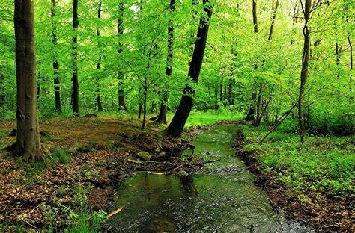
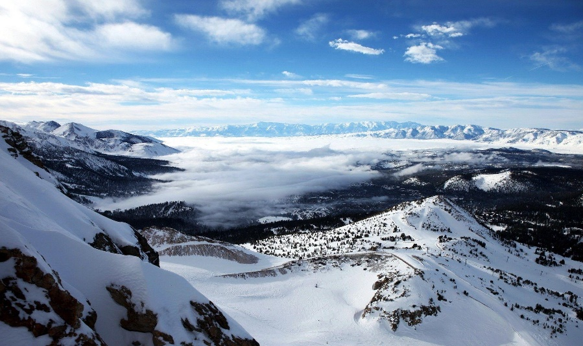
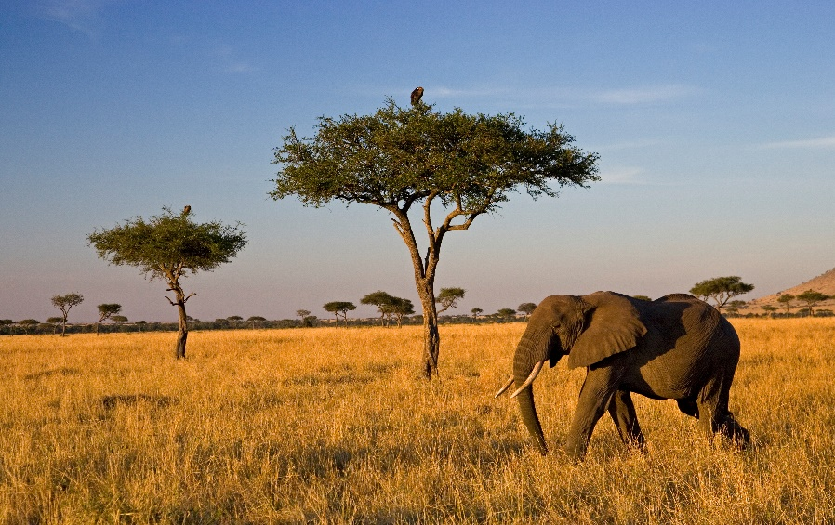
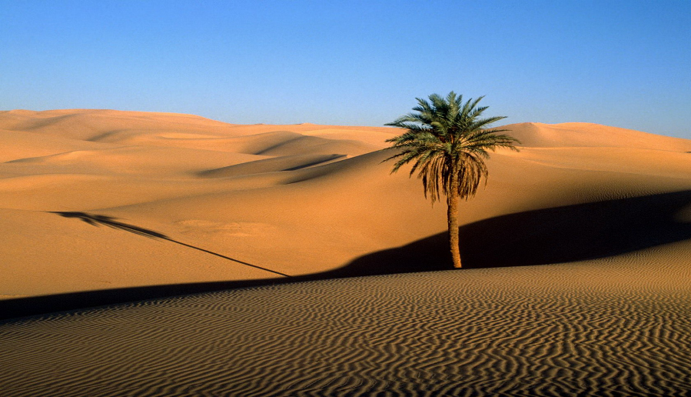
Terrestrial Ecosystems

Slide 17
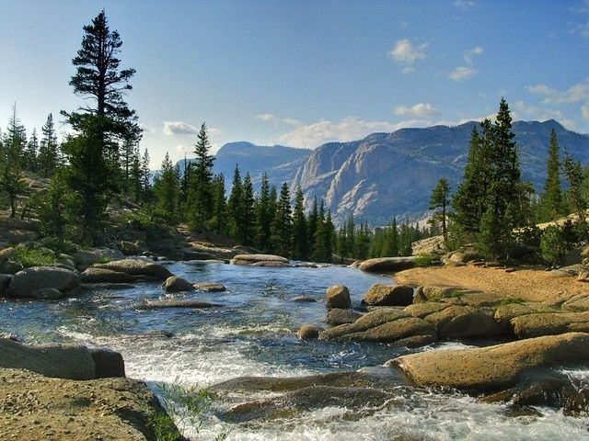
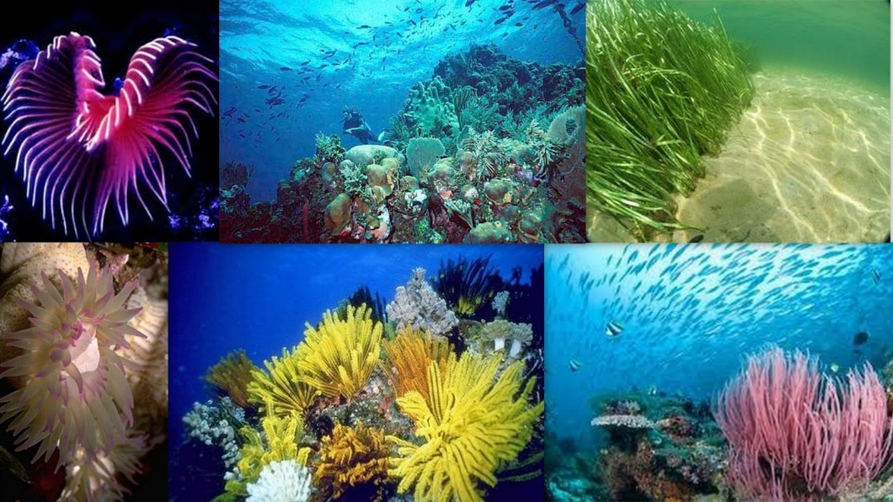
Aquatic Ecosystem
Aquatic ecosystems are ecosystems present in a body of water. These can be further divided into two types, namely:
Freshwater Ecosystem
Marine Ecosystem
Freshwater Ecosystem
The freshwater ecosystem is an aquatic ecosystem that includes lakes, ponds, rivers, streams and wetlands. These have no salt content in contrast with the marine ecosystem.
Marine Ecosystem
The marine ecosystem includes seas and oceans. These have a more substantial salt content and greater biodiversity in comparison to the freshwater ecosystem.

Slide 18
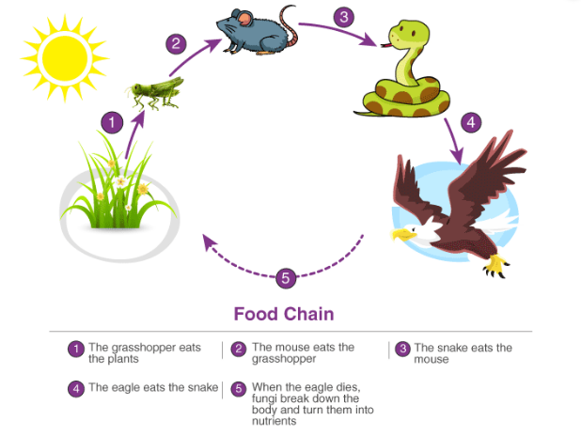
Important Ecological Concepts
1. Food Chain
The sun is the ultimate source of energy on earth. It provides the energy required for all plant life. The plants utilise this energy for the process of photosynthesis, which is used to synthesise their food.
During this biological process, light energy is converted into chemical energy and is passed on through successive trophic levels. The flow of energy from a producer, to a consumer and eventually, to an apex predator or a detritivore is called the food chain.
Dead and decaying matter, along with organic debris, is broken down into its constituents by scavengers. The reducers then absorb these constituents. After gaining the energy, the reducers liberate molecules to the environment, which can be utilised again by the producers.

Slide 19
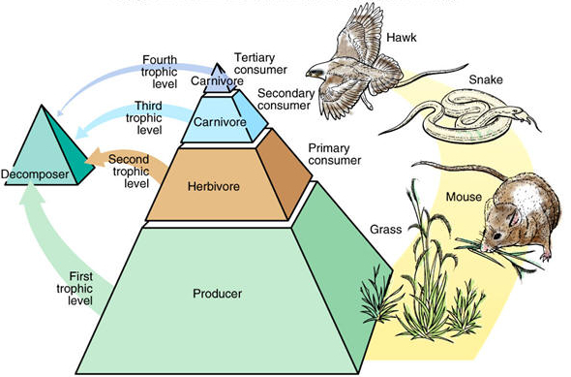
Important Ecological Concepts
2. Ecological Pyramids
An ecological pyramid is the graphical representation of the number, energy, and biomass of the successive trophic levels of an ecosystem. Charles Elton was the first ecologist to describe the ecological pyramid and its principals in 1927.
The biomass, number, and energy of organisms ranging from the producer level to the consumer level are represented in the form of a pyramid; hence, it is known as the ecological pyramid.

Slide 20
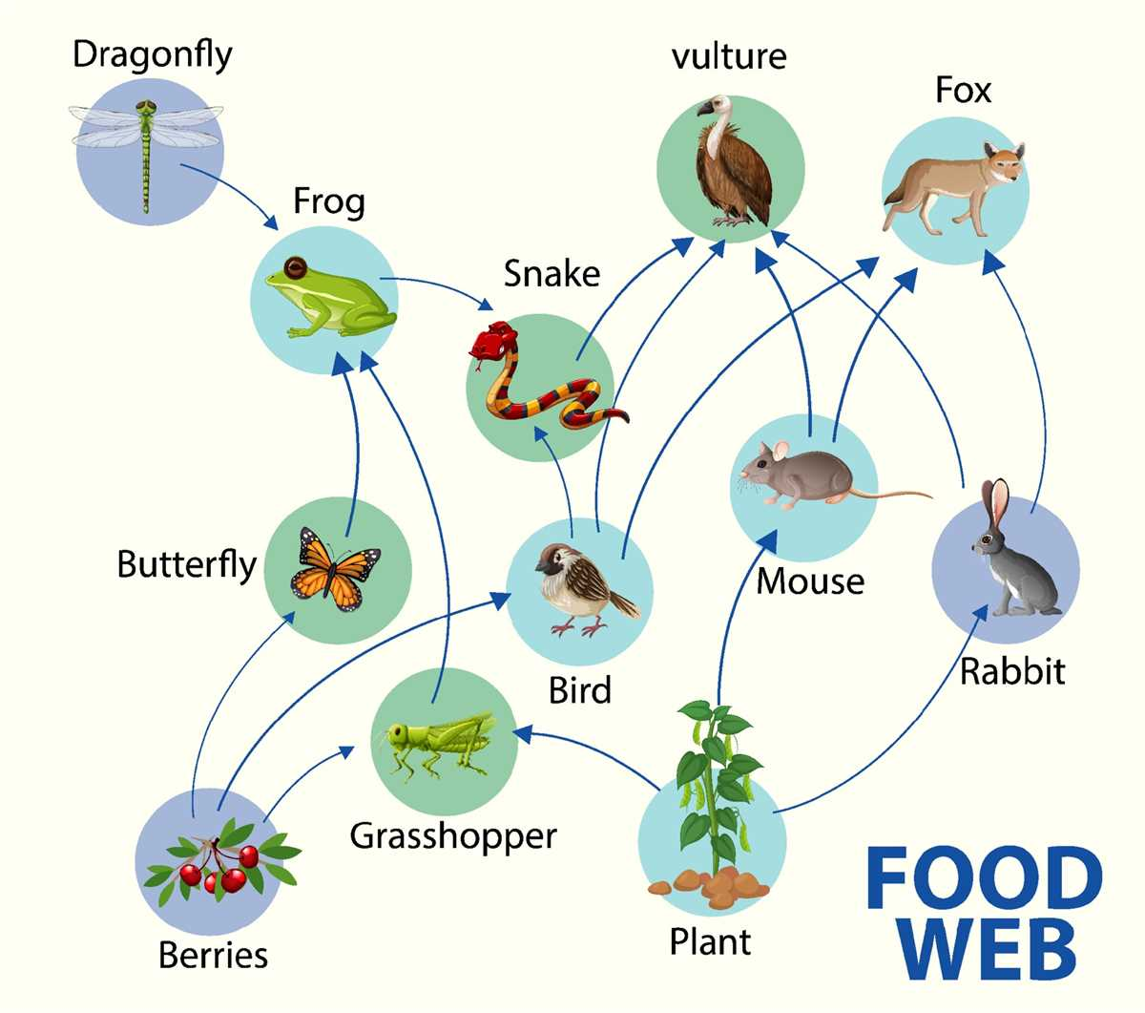
Important Ecological Concepts
3. Food Web
Food web is a network of interconnected food chains. It comprises all the food chains within a single ecosystem.
It helps in understanding that plants lay the foundation of all the food chains.

Slide 21
Participants in EM
Environmental Management (EM) involves multiple stakeholders who contribute to sustainability, conservation, and ecological protection.
These participants include governments, businesses, communities, and scientific organizations, each playing a unique role in environmental responsibility.

Slide 22
Participants in EM
1. Government & Regulatory Bodies 🏛️
Role: Formulate environmental laws, policies, and enforcement mechanisms.
Example:
United Nations Environment Programme (UNEP) – Develops global sustainability initiatives.
Environmental Protection Agency (EPA, USA) – Regulates pollution control and climate policies.
Ministry of Environment (India, China, EU, etc.) – Implements national environmental programs.
2. Corporations & Industries 🏭
Role: Adopt sustainable practices, reduce pollution, and integrate green supply chains.
Example:
Tesla – Innovates electric vehicles (EVs) to reduce carbon emissions.
Unilever – Uses renewable energy in production and promotes plastic waste reduction.
IKEA – Aims for a 100% circular economy by 2030 with sustainable sourcing.

Slide 23
Participants in EM
3. Non-Governmental Organizations (NGOs) 🌱
Role: Advocate for conservation, educate communities, and influence policies.
Example:
Greenpeace – Campaigns against deforestation, pollution, and climate change.
World Wildlife Fund (WWF) – Works on wildlife conservation and ecosystem restoration.
The Nature Conservancy – Focuses on protecting forests, oceans, and freshwater sources.
4. Scientists & Environmental Researchers 🔬
Role: Study climate change, develop eco-friendly technologies, and analyze pollution impacts.
Example:
NASA Climate Scientists – Monitor global warming trends using satellite data.
IPCC (Intergovernmental Panel on Climate Change) – Provides scientific reports on climate risks.
University Research Centers – Develop renewable energy solutions and sustainable agriculture techniques.

Slide 24
Participants in EM
5. Financial Institutions & Investors 💰
Role: Fund green projects, sustainable businesses, and renewable energy initiatives.
Example:
World Bank Green Bonds – Funds climate resilience projects in developing nations.
Sustainable Investment Funds – Encourage businesses to adopt ESG (Environmental, Social, Governance) practices.
Tesla’s Carbon Credit System – Allows companies to trade carbon credits for sustainability.
6. Consumers & General Public 👨‍👩‍👧‍👦
Role: Demand eco-friendly products, reduce waste, and support green businesses.
Example:
Zero-Waste Lifestyle – Consumers using reusable bags, composting, and reducing plastic.
Vegan & Plant-Based Diets – Reducing carbon footprint by consuming less meat.
Supporting Green Brands – Buying from companies with ethical environmental policies.

Slide 25
Participants in EM
7. Educational Institutions & Academics 🎓
Role: Teach sustainability, conduct research, and train future environmental leaders.
Example:
Harvard University’s Center for Climate, Health & Global Environment – Conducts climate research.
Schools Promoting Eco-Clubs – Encouraging students to participate in tree-planting and recycling.
Corporate Sustainability Training – Universities offering courses in environmental management.
8. Media & Environmental Activists 📢
Role: Spread awareness about climate issues, expose pollution, and push for policy changes.
Example:
Documentaries like "An Inconvenient Truth" (Al Gore) – Highlight climate change dangers.
Greta Thunberg’s Climate Movement – Youth activism for stronger climate policies.
National Geographic & BBC Earth – Educating the public on nature conservation.

Slide 26
Participants in EM
10. International Organizations & Agreements 🌎
Role: Facilitate global environmental policies, treaties, and cooperative projects.
Example:
Paris Climate Agreement – Countries committed to reducing greenhouse gas emissions.
United Nations Sustainable Development Goals (SDGs) – Promote sustainability worldwide.
COP28 (Conference of the Parties) – Global discussions on climate action.
Effective environmental management requires collaboration between governments, businesses, scientists, and communities. Everyone has a role to play in protecting the planet for future generations.

Slide 27
1. United Nations Environment Programme (UNEP)
Role: UNEP coordinates global efforts on environmental protection and sustainability. It provides guidelines, supports projects, and raises awareness about pressing environmental issues.
Key Activities:
Climate change adaptation programs.
Combating pollution through policy initiatives.
Promoting biodiversity conservation.

Slide 28
2. United Nations Framework Convention on Climate Change (UNFCCC)
Established: 1992 at the Rio Earth Summit Purpose: To stabilize greenhouse gas concentrations and prevent dangerous human interference with the climate system.
Major Agreements:
Kyoto Protocol (1997): Focused on reducing greenhouse gas emissions in developed countries.
Paris Agreement (2015): A global commitment to limit global warming to well below 2°C above pre-industrial levels.

Slide 29
3. Intergovernmental Panel on Climate Change (IPCC)
Purpose: Provides scientific assessments on climate change, its risks, and options for adaptation and mitigation.
Impact: IPCC reports serve as the basis for climate policy worldwide, influencing decisions at the highest levels.
4. Convention on Biological Diversity (CBD)
Established: 1992 Purpose: Conservation of biological diversity, sustainable use of its components, and fair sharing of benefits arising from genetic resources.
Example: Protected area networks to conserve critical habitats.

Slide 30
5. Ramsar Convention (1971)
Focus: Protection of wetlands of international importance, especially as waterfowl habitats.
Example: Recognizing Ramsar sites like Chilika Lake in India for wetland conservation.
6. World Meteorological Organization (WMO)
Role: Monitors and forecasts global weather and climate. Helps countries prepare for extreme weather events and mitigate risks related to climate change.
Example: Issuing global climate warnings about El Niño and La Niña effects.

Slide 31
7. Stockholm Convention (2001)
Purpose: Eliminates or restricts the production and use of persistent organic pollutants (POPs) that are harmful to health and the environment.
Example: Phasing out dangerous chemicals like DDT and PCBs.
8. Convention on International Trade in Endangered Species (CITES)
Established: 1973 Purpose: Regulates international trade in wildlife to prevent species from becoming endangered or extinct due to trade.
Example: Banning the trade of ivory to protect elephants.

Slide 32
9. Basel Convention (1989)
Focus: Controls the transboundary movement of hazardous wastes and their disposal.
Example: Preventing illegal export of toxic waste from developed countries to developing nations.
10. International Union for Conservation of Nature (IUCN)
Role: Maintains the Red List of Threatened Species and works on global conservation efforts.
Example: Identifying critically endangered species and promoting their protection through habitat restoration.

Slide 33
Environmental Concerns
In recent decades, human activities have caused severe degradation of the environment. This has led to a sharp increase in natural disasters like flash floods, tsunamis, and cyclones. Let’s break this down with examples:
1. Exploitation and Degradation of the Environment
Explanation: Uncontrolled industrialization, deforestation, and urban expansion have led to environmental degradation.
Examples:
Deforestation: Forests are cleared for agriculture and urban settlements, disrupting ecosystems and causing soil erosion.
Pollution: Industrial waste dumped into rivers results in water pollution and harm to aquatic life.
Excessive Resource Use: Overuse of natural resources like water has led to freshwater scarcity.

Slide 34
2. Flash Floods
Cause: Flash floods occur due to deforestation, poor urban planning, and climate change. Heavy rainfall overwhelms the natural drainage system, causing sudden flooding.
Example: In Uttarakhand, India (2013), heavy rainfall caused flash floods, leading to large-scale destruction and loss of life.
3. Tsunamis
Cause: Tsunamis are large sea waves triggered by undersea earthquakes or volcanic eruptions. Coastal degradation increases vulnerability.
Example: The 2004 Indian Ocean tsunami was one of the deadliest in history, causing over 230,000 deaths across multiple countries.

Slide 35
Significance of Environment Management for Contemporary/Modern Managers
Significance of Environmental Management with Examples
Environmental management refers to the systematic approach organizations and governments take to minimize environmental impact, preserve natural resources, and promote sustainable practices. Here are 10 significant aspects of environmental management, along with suitable examples:
1. Resource Conservation
Significance: Helps manage natural resources like water, energy, and raw materials efficiently to ensure their availability for future generations. Example: Coca-Cola India implemented a water stewardship program, focusing on water conservation, replenishment, and wastewater recycling to achieve water neutrality.

Slide 36
Following points shows the significance of EM:
2. Pollution Control
Significance: Reduces pollution from industrial, agricultural, and urban activities, protecting air, water, and soil quality. Example: The Delhi Metro Rail Corporation (DMRC) adopted CNG buses and solar panels, significantly reducing air pollution in the city.
3. Biodiversity Protection
Significance: Protects ecosystems and wildlife by preserving natural habitats and preventing deforestation and overexploitation. Example: The reforestation project in the Western Ghats of India helps restore biodiversity by planting native species and protecting endangered wildlife.

Slide 37
Following points shows the significance of EM:
4. Climate Change Mitigation
Significance: Reduces greenhouse gas emissions and promotes renewable energy to combat climate change. Example: Tata Power’s wind and solar farms contribute to India’s renewable energy goals, reducing dependence on fossil fuels.
5. Waste Management
Significance: Promotes the reduction, recycling, and proper disposal of waste to prevent land and water contamination. Example: ITC’s “Wow - Wealth Out of Waste” initiative encourages urban households to segregate and recycle waste.

Slide 38
Following points shows the significance of EM:
6. Compliance with Regulations
Significance: Ensures organizations adhere to environmental laws and avoid penalties while maintaining ethical standards. Example: Infosys adheres to India’s energy and emissions regulations by using green buildings and achieving carbon neutrality.
7. Sustainable Development
Significance: Balances economic growth with environmental protection to ensure long-term sustainability. Example: Suzlon Energy Limited develops wind energy solutions to provide sustainable power while preserving the environment.

Slide 39
Following points shows the significance of EM:
8. Risk Mitigation
Significance: Identifies and mitigates risks related to environmental disasters, accidents, or resource depletion. Example: The Chambal River Basin project focuses on preventing soil erosion and mitigating the risk of droughts in the region.
9. Corporate Social Responsibility (CSR)
Significance: Encourages companies to integrate environmental protection into their CSR initiatives, benefiting society. Example: Mahindra & Mahindra launched the “Lifeline for Tigers” program, contributing to tiger conservation and habitat restoration.

Slide 40
Following points shows the significance of EM:
10. Improved Public Health
Significance: Reduces environmental hazards like air and water pollution, leading to better health outcomes for communities. Example: Clean Ganga Mission (Namami Gange) focuses on cleaning the river Ganga, improving the health and well-being of millions of people dependent on it.
So, Environmental management is critical for achieving sustainability, fostering economic growth, and ensuring a better quality of life for all. These examples highlight how effective practices can address environmental challenges and create a positive impact globally.

Slide 41
Exercise
Identify any one important significance from above and prepare case study on the same

Slide 42
Corporate Responsibilities:
Corporate environmental responsibility refers to the duties and commitments of businesses to minimize their environmental impact and promote sustainability.
1. Compliance with Environmental Laws and Regulations
Example: A manufacturing company adheres to the Clean Air Act by installing emission control systems to reduce air pollution.
2. Sustainable Resource Management
Example: A paper company implements a tree-planting program to replace the trees it uses, ensuring a continuous and balanced supply.
3. Pollution Prevention and Waste Reduction
Example: A beverage company replaces plastic straws with biodegradable paper straws to minimize plastic waste.
4. Energy Efficiency and Conservation
Example: A tech company like Google powers its data centers with renewable energy sources (Solar, wind,water, biomass energy) reducing fossil fuel(Petrol, Dizel, natural gas, coal) dependency.

Slide 43
Corporate Responsibilities:
5. Carbon Footprint Reduction
Example: An airline company invests in fuel-efficient aircraft and carbon offset programs to minimize its carbon emissions.
6. Eco-Friendly Product Design
Example: An electronics company introduces energy-efficient appliances that consume less electricity and last longer.
7. Water Conservation
Example: A textile company implements water recycling systems to treat and reuse wastewater in production processes.
8. Green Supply Chain Management
Example: A retail company partners with sustainable suppliers who follow ethical and eco-friendly practices in production.
9. Corporate Social Responsibility (CSR) Initiatives
Example: A company funds reforestation projects or community clean-up drives to enhance local environmental conditions.
10. Employee and Community Awareness Programs
Example: A corporation conducts eco-awareness training sessions for employees and educates consumers about responsible consumption.

Slide 44
Overall Benefits of Corporate Environmental Responsibility & Sustainability
When corporations take responsibility for environmental management and sustainability, they contribute to a healthier planet, stronger economies, and better communities.
Below are the key benefits:
1. Reduction in Carbon Footprint & Climate Change Mitigation 🌍
✅ Lower greenhouse gas emissions from energy-efficient operations. ✅ Increased use of renewable energy reduces dependence on fossil fuels. ✅ Sustainable practices slow down global warming and extreme weather events.
Example: Google and Apple run on 100% renewable energy, reducing carbon emissions significantly.

Slide 45
Overall Benefits of Corporate Environmental Responsibility & Sustainability
2. Conservation of Natural Resources 🌱
✅ Sustainable sourcing helps protect forests, water, and minerals. ✅ Recycling and circular economy reduce waste production. ✅ Efficient water usage ensures clean water availability for future generations.
Example: Unilever reduced its water footprint by 40% in its manufacturing units.
3. Improved Air and Water Quality 💨💧
✅ Less industrial pollution improves air and water quality. ✅ Green supply chains reduce toxic emissions from transportation and manufacturing. ✅ Cleaner water bodies benefit aquatic life and human health.
Example: Tesla’s electric vehicles (EVs) help reduce air pollution in cities.

Slide 46
Overall Benefits of Corporate Environmental Responsibility & Sustainability
4. Increased Corporate Profitability & Cost Savings 💰
✅ Energy-efficient buildings and machines lower operational costs. ✅ Waste reduction and recycling save money on raw materials. ✅ Green innovations open new revenue streams (e.g., biodegradable packaging).
Example: Walmart saves millions annually through energy-efficient LED lighting in stores.
5. Compliance with Government Regulations 📜
✅ Avoids fines and penalties for violating environmental laws. ✅ Meets carbon neutrality goals set by international agreements (e.g., Paris Climate Agreement). ✅ Government incentives and tax benefits for eco-friendly initiatives.
Example: IKEA follows strict European sustainability laws and has committed to being climate positive by 2030.

Slide 47

Ethics and the Environment 🌍
What is Environmental Ethics?
Environmental ethics is a branch of philosophy that examines the moral relationship between humans and the natural world. It guides how individuals, businesses, and governments should treat the environment responsibly.
Key Questions in Environmental Ethics:
🔹 Do humans have a moral duty to protect nature? 🔹 Should businesses prioritize profits over sustainability? 🔹 Do animals and plants have rights? 🔹 How can we balance economic growth with environmental conservation?

Slide 48
Principles of Environmental Ethics
1. Sustainability 🌱
Using resources wisely so future generations can also benefit.
Encouraging renewable energy, conservation, and recycling.
Example: Companies like Tesla promote electric vehicles to reduce fossil fuel use.
2. Responsibility 🏭
Individuals and organizations are responsible for minimizing environmental harm.
Businesses must adopt green supply chains and reduce waste.
Example: IKEA uses only sustainably sourced wood to protect forests.

Slide 49
Principles of Environmental Ethics
3. Justice & Fairness ⚖️
Fair distribution of environmental benefits and burdens.
Preventing environmental racism (where low-income communities face more pollution).
Example: The Paris Climate Agreement ensures global cooperation in fighting climate change.
4. Respect for Nature 🌳
Recognizing the intrinsic value of plants, animals, and ecosystems.
Avoiding activities that lead to deforestation, pollution, and habitat destruction.
Example: National parks and protected areas safeguard biodiversity.
5. Precautionary Principle ⚠️
If an action may harm the environment, precautionary measures should be taken even if the full effects are not yet known.
Example: Governments banning harmful pesticides before they cause irreversible damage.

Slide 50
Ethical Issues in Environmental Management
Climate Change & Corporate Responsibility – Should businesses be held accountable for their carbon emissions?
Deforestation & Biodiversity Loss – How can companies balance resource extraction with conservation?
Waste Management & Pollution – Are businesses doing enough to reduce plastic waste?
Animal Rights & Ethical Consumption – Should people avoid products tested on animals?
Environmental Justice – Are poorer communities unfairly affected by industrial pollution?
Ethics and the environment are deeply connected. By following ethical principles like sustainability, responsibility, and fairness, individuals and businesses can protect the planet while ensuring a just future for all.

Slide 51
Examples of Ethical Issues in Environmental Management
sustainability, responsibility, and fairness.
Sustainability: Acting in a way that meets current needs without compromising the ability of future generations to meet theirs. Example: Using renewable energy sources like solar and wind instead of fossil fuels to reduce carbon emissions.
Responsibility: Taking accountability for actions that impact the environment and striving to reduce harm. Example: A company ensuring its manufacturing process does not pollute local rivers or depleting natural resources irresponsibly.
Fairness: Ensuring equal access to natural resources and a healthy environment for all, including future generations. Example: Implementing fair trade practices that protect farmers and communities while promoting eco-friendly agriculture.

Slide 52
International Environmental Movements
International environmental movements are collective efforts by individuals, organizations, and governments to address global environmental issues such as climate change, deforestation, pollution, and biodiversity loss. These movements aim to promote sustainability, conservation, and policy changes to protect the planet for future generations.
1. The Green Movement
Origin: 1970s
Focus: Environmental awareness, conservation, and sustainable development.
Impact: Encourages eco-friendly policies, promotes renewable energy, and raises awareness about global warming.
2. Earth Day Movement
Origin: April 22, 1970 (Founded by U.S. Senator Gaylord Nelson)
Focus: Public awareness about environmental issues.
Impact: Led to the establishment of the Environmental Protection Agency (EPA) in the U.S. and inspired similar initiatives worldwide.

Slide 53
International Environmental Movements
3. Greenpeace
Founded: 1971 (Canada)
Focus: Climate change, deforestation, anti-nuclear campaigns, and ocean conservation.
Impact: Led efforts to ban commercial whaling, halt nuclear testing, and reduce toxic waste.
4. Fridays for Future (FFF)
Founded: 2018 (Sweden) by Greta Thunberg
Focus: Climate change activism, demanding urgent action from governments.
Impact: Inspired millions of students globally to participate in climate strikes, influencing political discourse on climate policies.
5. The Paris Agreement (2015)
A global treaty under the United Nations Framework Convention on Climate Change (UNFCCC).
Aim: Limit global warming to below 2°C, preferably 1.5°C, above pre-industrial levels.
Impact: Countries committed to reducing greenhouse gas emissions through Nationally Determined Contributions (NDCs).
6. The Chipko Movement (India)
Origin: 1973 (Uttarakhand, India)
Focus: Forest conservation and preventing deforestation.
Impact: Inspired eco-movements worldwide, leading to stricter forest protection laws in India.

Slide 54
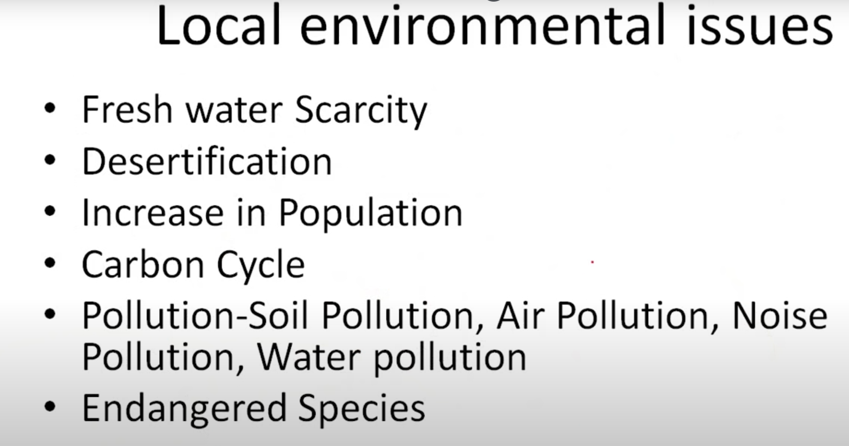

Slide 55
1. Freshwater Scarcity
Explanation: Freshwater scarcity at the local level is caused by over-extraction, pollution, and climate change. It directly affects communities that rely on nearby rivers, lakes, and groundwater sources for drinking water, agriculture, and industry.
Examples:
Maharashtra, India: Several districts face chronic water shortages due to low rainfall and poor water management.
California, USA: Prolonged droughts have led to water rationing in certain areas.
Rajasthan, India: Faces severe water scarcity in rural regions due to arid conditions and groundwater depletion.
Impact:
Affects agriculture, leading to reduced food production.
Increases the burden on women and children to collect water in rural areas.
Triggers health issues due to lack of clean drinking water.

Slide 56
2. Desertification
Explanation: Desertification is the degradation of land in arid, semi-arid, and dry sub-humid areas due to human activities and climatic variations. It reduces land productivity, making it difficult to sustain agriculture and vegetation.
Examples:
Thar Desert, India: Desertification is expanding due to overgrazing and deforestation.
Africa’s Sahel Region: One of the most affected areas by desertification, causing food insecurity and forced migration.
China’s Gobi Desert: Expanding rapidly due to deforestation and over-farming.
Impact:
Loss of fertile land for agriculture.
Increases poverty and food scarcity.
Contributes to biodiversity loss.

Slide 57
3. Increase in Population
Explanation: Population growth puts pressure on local resources like water, land, and energy. Rapid urbanization increases demand for housing, food, and infrastructure, often leading to environmental degradation.
Examples:
Delhi, India: Population growth has led to severe air pollution, water shortages, and traffic congestion.
Lagos, Nigeria: Overpopulation has resulted in inadequate waste management and water supply issues.
Beijing, China: Faces challenges in managing air quality due to high population density and industrial growth.
Impact:
Strains natural resources and public services.
Increases pollution levels.
Reduces the quality of life in urban areas.

Slide 58
4. Carbon Cycle
Explanation: The carbon cycle involves the exchange of carbon among the atmosphere, oceans, soil, and living organisms. Human activities like deforestation and burning fossil fuels disrupt the natural carbon balance, contributing to global warming.
Examples:
Deforestation in the Amazon: Reduces carbon absorption by trees, increasing atmospheric CO₂.
Industrial Emissions: Power plants release large quantities of carbon into the atmosphere.
Soil Carbon Loss: Poor agricultural practices lead to loss of carbon from soil, reducing fertility.
Impact:
Contributes to climate change.
Reduces agricultural productivity.
Increases frequency of extreme weather events.

Slide 59
5. Pollution (Soil, Air, Noise, Water)
Explanation: Pollution affects local environments in multiple ways, harming human health and ecosystems. It can be categorized into different types:
Soil Pollution: Contamination of soil by chemicals like pesticides and industrial waste.
Air Pollution: Emission of pollutants like carbon monoxide, sulfur dioxide, and particulate matter.
Noise Pollution: Excessive noise from industries, vehicles, and urban activities.
Water Pollution: Contamination of rivers, lakes, and groundwater by sewage, industrial waste, and chemicals.
Examples:
Air Pollution in Delhi: Severe smog due to vehicle emissions and crop stubble burning.
Water Pollution in the Ganges River: Industrial and domestic waste causes health issues for nearby communities.
Noise Pollution in Mumbai: Traffic and construction activities create noise levels far beyond permissible limits.
Impact:
Causes respiratory and cardiovascular diseases.
Harms aquatic life and reduces water quality.
Reduces soil fertility and affects crop yields.

Slide 60
6. Endangered Species
Explanation: Local ecosystems are home to various species that face extinction due to habitat loss, poaching, pollution, and climate change. The loss of species affects the balance of ecosystems and reduces biodiversity.
Examples:
Asiatic Lion: Found in Gujarat’s Gir Forest, threatened by habitat loss.
Olive Ridley Turtles: Face risks from plastic pollution and illegal fishing along India’s coasts.
Great Indian Bustard: Critically endangered due to habitat destruction in Rajasthan and Gujarat.
Impact:
Disrupts ecosystems and food chains.
Reduces genetic diversity.
Affects human communities dependent on wildlife for their livelihoods.

Slide 61
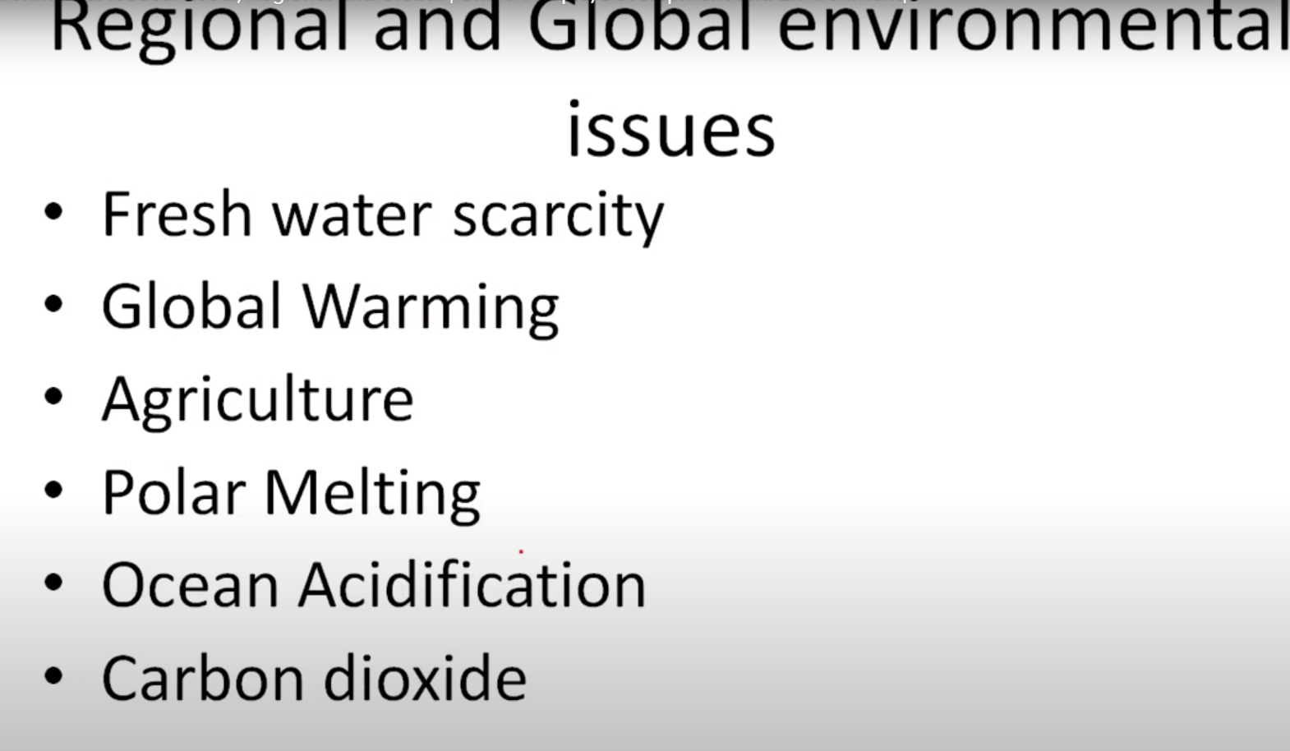

Slide 62
1. Freshwater Scarcity
Explanation: Freshwater scarcity occurs when the demand for water exceeds the available supply or when water quality is too poor for human use. This issue is driven by population growth, industrialization, and climate change, leading to droughts, reduced water availability, and increased competition for water resources.
Examples:
Cape Town, South Africa: Experienced a severe water crisis in 2018 known as "Day Zero," when the city nearly ran out of water.
India: The city of Chennai faced extreme water shortages in 2019 due to low rainfall and groundwater depletion.
Middle East: Countries like Yemen and Jordan suffer chronic water shortages due to arid conditions and mismanagement of resources.
Impact:
Affects drinking water availability and sanitation.
Reduces agricultural productivity, leading to food shortages.
Causes conflicts over water resources.

Slide 63
2. Global Warming
Explanation: Global warming refers to the increase in Earth's average surface temperature due to rising greenhouse gas emissions, primarily carbon dioxide (CO₂), methane (CH₄), and nitrous oxide (N₂O). It accelerates climate change, causing extreme weather patterns and rising sea levels.
Examples:
Heatwaves in Europe (2022): Record-breaking temperatures caused wildfires and heat-related deaths.
Rising Sea Levels: Low-lying countries like Maldives and Bangladesh face the threat of being submerged.
Glacier Melting in the Himalayas: Poses risks to water availability for millions in South Asia.
Impact:
Increases the frequency of natural disasters like hurricanes and floods.
Affects biodiversity and disrupts ecosystems.
Impacts human health with heat-related illnesses and vector-borne diseases.

Slide 64
3. Agriculture
Explanation: Agriculture is both a cause and a victim of environmental issues. Unsustainable agricultural practices deplete resources, contribute to deforestation, and accelerate global warming. On the other hand, climate change impacts crop yields, threatens food security, and alters growing seasons.
Examples:
Droughts in Sub-Saharan Africa: Reduce crop yields, leading to food crises.
Shifts in Crop Production: Coffee and tea-growing regions are shrinking due to changing temperatures.
Deforestation for Agriculture: The Amazon rainforest is being cleared for cattle ranching and soybean cultivation.
Impact:
Loss of biodiversity and degradation of arable land.
Increases greenhouse gas emissions from livestock and fertilizers.
Food shortages and higher prices.

Slide 65
4. Polar Melting
Explanation: Polar melting refers to the rapid loss of ice in polar regions, mainly in the Arctic and Antarctic. This is a direct result of global warming and contributes to rising sea levels and loss of habitat for polar species. It also affects global weather patterns.
Examples:
Arctic Ice Melt: The Arctic has lost over 75% of its summer sea ice volume since the 1970s.
Antarctic Ice Sheets: Rapid thinning and melting of the West Antarctic Ice Sheet contribute significantly to global sea-level rise.
Greenland Ice Melt: If the Greenland ice sheet melts completely, global sea levels could rise by up to 7 meters.
Impact:
Coastal cities like New York and Mumbai are at risk of flooding.
Loss of habitat for species like polar bears, seals, and walruses.
Disruption of ocean currents and weather systems.

Slide 66
5. Ocean Acidification
Explanation: Ocean acidification is caused by increased CO₂ absorption by oceans, leading to a decrease in pH levels. This affects marine life, especially organisms that rely on calcium carbonate to form shells and skeletons (e.g., corals and shellfish).
Examples:
Coral Bleaching: The Great Barrier Reef in Australia has suffered extensive bleaching events due to acidification and warming seas.
Pacific Northwest (USA): Acidification affects oyster farms, causing significant economic losses.
Decline in Marine Biodiversity: Acidification affects the survival of fish larvae and disrupts food chains.
Impact:
Reduces biodiversity in marine ecosystems.
Affects fisheries and aquaculture, threatening food security.
Disrupts livelihoods dependent on marine resources.

Slide 67
6. Carbon Dioxide (CO₂) Emissions
Explanation: Carbon dioxide is the primary greenhouse gas responsible for global warming. Human activities, such as burning fossil fuels, deforestation, and industrial processes, release large amounts of CO₂ into the atmosphere.
Examples:
Industrial Emissions: Power plants and factories contribute significantly to CO₂ levels.
Transportation: Vehicles burning fossil fuels are a major source of emissions.
Deforestation in the Amazon: Reduces the Earth's capacity to absorb CO₂, exacerbating global warming.
Impact:
Worsens climate change and its associated effects.
Reduces air quality and impacts public health.
Increases the frequency and severity of natural disasters.

Slide 68
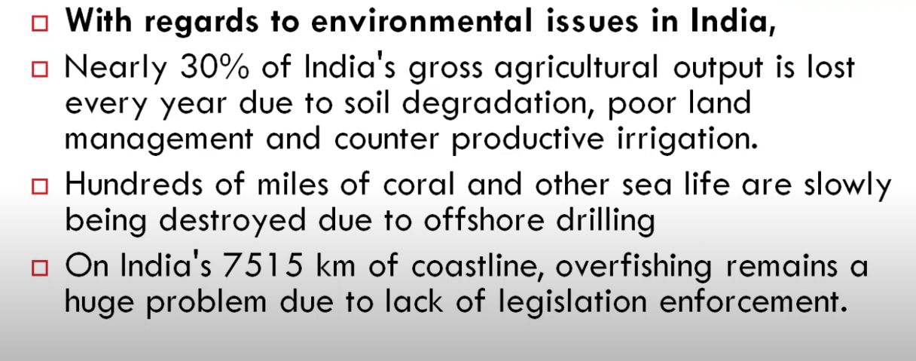

Slide 69
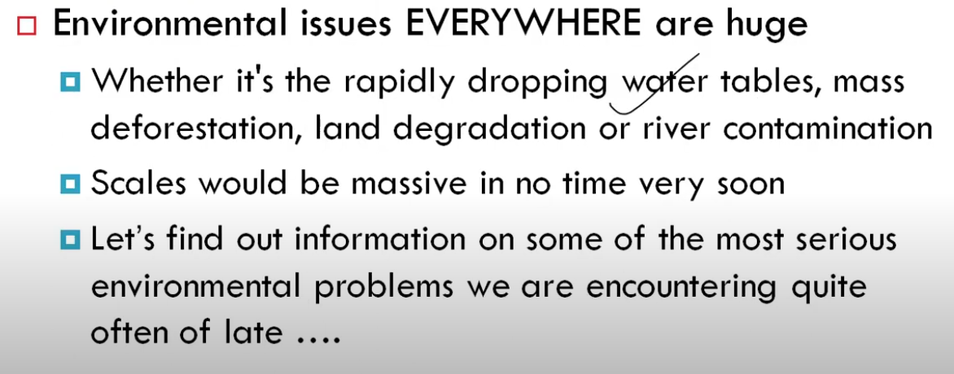

Slide 70
Main Environmental Issues with Examples
1. Water Pollution
Cause: Discharge of industrial waste, untreated sewage, and plastic into water bodies. Example:
Ganga River Pollution (India): Untreated sewage and industrial effluents have made the Ganga one of the most polluted rivers.
Minamata Disease (Japan): Caused by mercury poisoning from industrial waste dumped into Minamata Bay.

Slide 71
2. Air Pollution
Cause: Emissions from vehicles, industries, and burning fossil fuels. Example:
Delhi Air Quality Crisis (India): High levels of particulate matter (PM2.5 and PM10) during winter due to stubble burning and vehicular pollution.
London Smog (1952): A deadly smog caused by coal burning killed thousands.

Slide 72
3. Soil/Solid Waste Pollution
Cause: Dumping of plastic, hazardous waste, and excessive use of pesticides. Example:
Landfill Sites (Mumbai, India): Overflowing landfills like Deonar are causing soil and groundwater contamination.
Excessive Pesticide Use: Leads to loss of soil fertility and contamination of food crops.

Slide 73
4. Deforestation
Cause: Clearing forests for agriculture, urbanization, and logging. Example:
Amazon Rainforest Deforestation: Massive deforestation for cattle ranching and soybean production.
Western Ghats (India): Forests are cleared for mining and plantations, affecting biodiversity.

Slide 74
5. Medical Waste
Cause: Improper disposal of hospital waste like syringes, masks, and biohazard materials. Example:
COVID-19 Pandemic: Led to a surge in medical waste (PPE kits, masks), creating disposal challenges.
Hospital Waste Mismanagement: Can spread diseases like hepatitis and tuberculosis.

Slide 75
6. Noise Pollution
Cause: Traffic, construction activities, industrial noise, and loudspeakers. Example:
Urban Areas (Mumbai, Delhi): Constant exposure to high noise levels can cause hearing loss, stress, and heart issues.
Airports: Aircraft noise disturbs nearby residents, especially in areas close to major airports.

Slide 76
Environmental Issues relevant to India
India faces several significant environmental challenges due to rapid industrialization, population growth, and climate change.
Some of the most pressing environmental issues include:
Air Pollution
Water Pollution & Scarcity
Deforestation & Biodiversity Loss
Climate Change & Extreme Weather Events
Waste Management Crisis
Soil Degradation & Desertification
Energy Crisis & Dependence on Fossil Fuels
Marine & Coastal Pollution
Loss of Wetlands & Water Bodies
Human-Wildlife Conflict

Slide 77
Examples of environmental challenges
Air Pollution
Example: Emissions from vehicles and factories release harmful gases like CO2 and NOx, contributing to respiratory problems and global warming.
Water Pollution & Scarcity
Example: Industrial waste and plastic pollution in rivers reduce freshwater availability and harm aquatic ecosystems.
Deforestation & Biodiversity Loss
Example: Clearing forests for agriculture reduces habitats, leading to species extinction and disrupting ecosystems.
Climate Change & Extreme Weather Events
Example: Rising global temperatures cause more frequent and severe storms, floods, and droughts.
Waste Management Crisis
Example: Poor disposal of electronic waste contaminates soil and water with toxic materials like lead and mercury.
Soil Degradation & Desertification
Example: Overgrazing and deforestation lead to loss of fertile topsoil, reducing agricultural productivity.
Energy Crisis & Dependence on Fossil Fuels
Example: Heavy reliance on coal and oil accelerates greenhouse gas emissions and depletes finite resources.
Marine & Coastal Pollution
Example: Oil spills and plastic waste harm marine life, coral reefs, and ecosystems.
Loss of Wetlands & Water Bodies
Example: Draining wetlands for urban development disrupts natural water filtration systems and habitats for many species.
Human-Wildlife Conflict
Example: Expansion of human settlements into wildlife habitats increases encounters, leading to harm for both humans and animals.

Slide 78
Environmental Issues relevant to India
1. Air Pollution
India has some of the most polluted cities in the world, with high levels of PM2.5 and PM10 particles.
Major contributors: vehicle emissions, industrial pollution, crop burning, and construction dust.
Delhi and other metropolitan cities suffer from severe smog, especially in winter.
2. Water Pollution & Scarcity
Major rivers like the Ganges and Yamuna are heavily polluted due to industrial waste, sewage discharge, and religious practices.
Groundwater depletion is a serious issue due to over-extraction for agriculture and drinking water.
Waterborne diseases are a concern due to contaminated water sources.
3. Deforestation & Biodiversity Loss
Rapid urbanization, illegal logging, and mining are leading to deforestation.
Loss of forests threatens biodiversity, including endangered species like the Bengal tiger and Indian elephant.
Encroachment into wildlife habitats increases human-wildlife conflicts.

Slide 79
Environmental Issues relevant to India
4. Climate Change & Extreme Weather Events
Rising temperatures are leading to more frequent heatwaves, droughts, and floods.
Melting glaciers in the Himalayas threaten water availability in the long term.
Cyclones and erratic monsoon patterns disrupt agriculture and livelihoods.
5. Waste Management Crisis
India generates massive amounts of plastic, electronic, and biomedical waste.
Poor waste segregation and lack of proper disposal facilities result in landfill overflow.
Open dumping and burning of waste contribute to air and soil pollution.
6. Soil Degradation & Desertification
Overuse of chemical fertilizers and pesticides is degrading soil fertility.
Unsustainable agricultural practices are leading to desertification, particularly in Rajasthan and parts of Gujarat.
Deforestation exacerbates soil erosion and loss of arable land.

Slide 80
Environmental Issues relevant to India
7. Energy Crisis & Dependence on Fossil Fuels
India still relies heavily on coal for electricity, leading to high carbon emissions.
Despite progress in renewable energy, fossil fuels continue to dominate.
Transition to clean energy is slow due to economic and infrastructural challenges.
8. Marine & Coastal Pollution
Untreated sewage and industrial waste are polluting coastal waters.
Plastic waste accumulation is harming marine life.
Overfishing and destruction of mangroves threaten marine biodiversity.
9. Loss of Wetlands & Water Bodies
Encroachment and pollution have reduced the size of wetlands, affecting local ecosystems.
Urban expansion is leading to the destruction of natural water reservoirs.
Wetland loss impacts migratory birds and aquatic biodiversity.

Slide 81
Environmental Issues relevant to India
10. Human-Wildlife Conflict
Expanding human settlements and agriculture are violating on wildlife habitats.
Increased encounters with elephants, leopards, and tigers lead to casualties on both sides.
Conservation efforts struggle due to land-use conflicts and lack of awareness.

Slide 82
Government and Public Initiatives on Environmental Issues relevant to India
Namami Gange Programme: Aims to clean the Ganges River.
National Clean Air Programme (NCAP): Targets reduction in air pollution.
Swachh Bharat Abhiyan: Focuses on waste management and sanitation.
Renewable Energy Expansion: Investment in solar, wind, and hydro energy.
Afforestation Programs: Encouraging tree plantation to combat deforestation
Way Forward
Strengthening environmental policies and enforcement.
Promoting sustainable urban planning and waste management.
Encouraging renewable energy and green technologies.
Raising public awareness and involving local communities in conservation.

Slide 83
Current Initiatives
Namami Gange Programme
Objective: Cleaning and rejuvenation of the Ganges River.
Focus: Reducing industrial discharge and promoting sustainable farming practices along the riverbanks.
National Clean Air Programme (NCAP)
Aim: Reduce air pollution by 20–30% by 2024 in 102 cities.
Strategy: Implementing better monitoring and pollution control measures.
Swachh Bharat Abhiyan
Focus: Improving waste management and achieving open defecation-free status.
Impact: Enhanced cleanliness and awareness about waste disposal.
Renewable Energy Expansion
Investment in solar, wind, and hydro energy to reduce dependence on fossil fuels.
Target: Achieving 500 GW of non-fossil fuel capacity by 2030.
Afforestation Programs
Encourages tree plantation drives to combat deforestation and restore ecosystems.

Slide 84
Way Forward
Strengthening Environmental Policies and Enforcement: Ensuring stricter implementation of existing laws and creating new regulations for emerging challenges.
Promoting Sustainable Urban Planning and Waste Management: Developing eco-friendly infrastructure and efficient waste management systems.
Encouraging Renewable Energy and Green Technologies: Supporting innovation and adoption of clean energy solutions.
Raising Public Awareness and Community Involvement: Engaging local communities in conservation efforts and educating the public on sustainable practices.

Slide 85
THANK YOU!!!

Slide 86
Conclusion
Each of these environmental issues has serious implications for human health and ecosystems. Sustainable practices, proper waste management, and strict regulations can help mitigate these problems.

